Slide 1

INTERNSHIP AT
WebIMS: The All-in-One EHR, Practice Management and Billing Software

Slide 2
About Company
Meditab is an EMR software company and practice management system. We offer leading multispecialty EHR software solutions designed by providers to meet the unique needs of your practice.
Meditab’s products:
IMS and WebIMS
Dr. Catalyst EHR
Honest Abe Apps
Dosepacker

Slide 3
About Project: WebIMS
IMS is the one complete EHR for all clinical, billing, and practice management needs.
IMS does so much more than a typical EMR software, IMS integrates every aspect of medical practice into one comprehensive ecosystem. IMS includes practice management, medical billing, ICD-10 codes, patient engagement, telemedicine features, and more — providers can save time and money while improving their practice efficiency.
IMS is all about efficiency, providing customers with everything they need to keep their practice running smoothly.

Slide 4
Week 1: Induction Program
Week 1 was simply an orientation program where we learn different aspects of meditab company:
○ HIPPA ACT
○ Cyber Security session
○ US Healthcare
○ Workplace Ethics
○ Departmental overview
○ Gmail etiquettes
○ Ownership and values
○ Floor walk around

Slide 5
Week 2: US Healthcare, HIPPA and G suite
1). Explored and learned about US healthcare, patient lifecycle, and it’s flow.
2). Prepared detailed document on US healthcare. Including topics like entities (patient, payer and providers), insurance policies (Medicare, Medicaid, CHIP), PCP, Copay, Coinsurance and Deductible.
3). Prepared for HIPPA(Health Insurance Portability and Accountability Act) test, gave the test, passed it and earned certificate.
4). Prepared for G Suite test, gave the test, passed it and earned certificate.
5). Practiced Touch Typing everyday on MEM Portal.

Slide 6
Week 3: Understanding Product, Testing and Learning Touch Typing.
1). Attended WebIMS Product Training sessions.
2). Understood what our product is about.
3). Started manually testing Scheduler Module.
4). In MEM portal, practiced Touch Typing everyday.

Slide 7
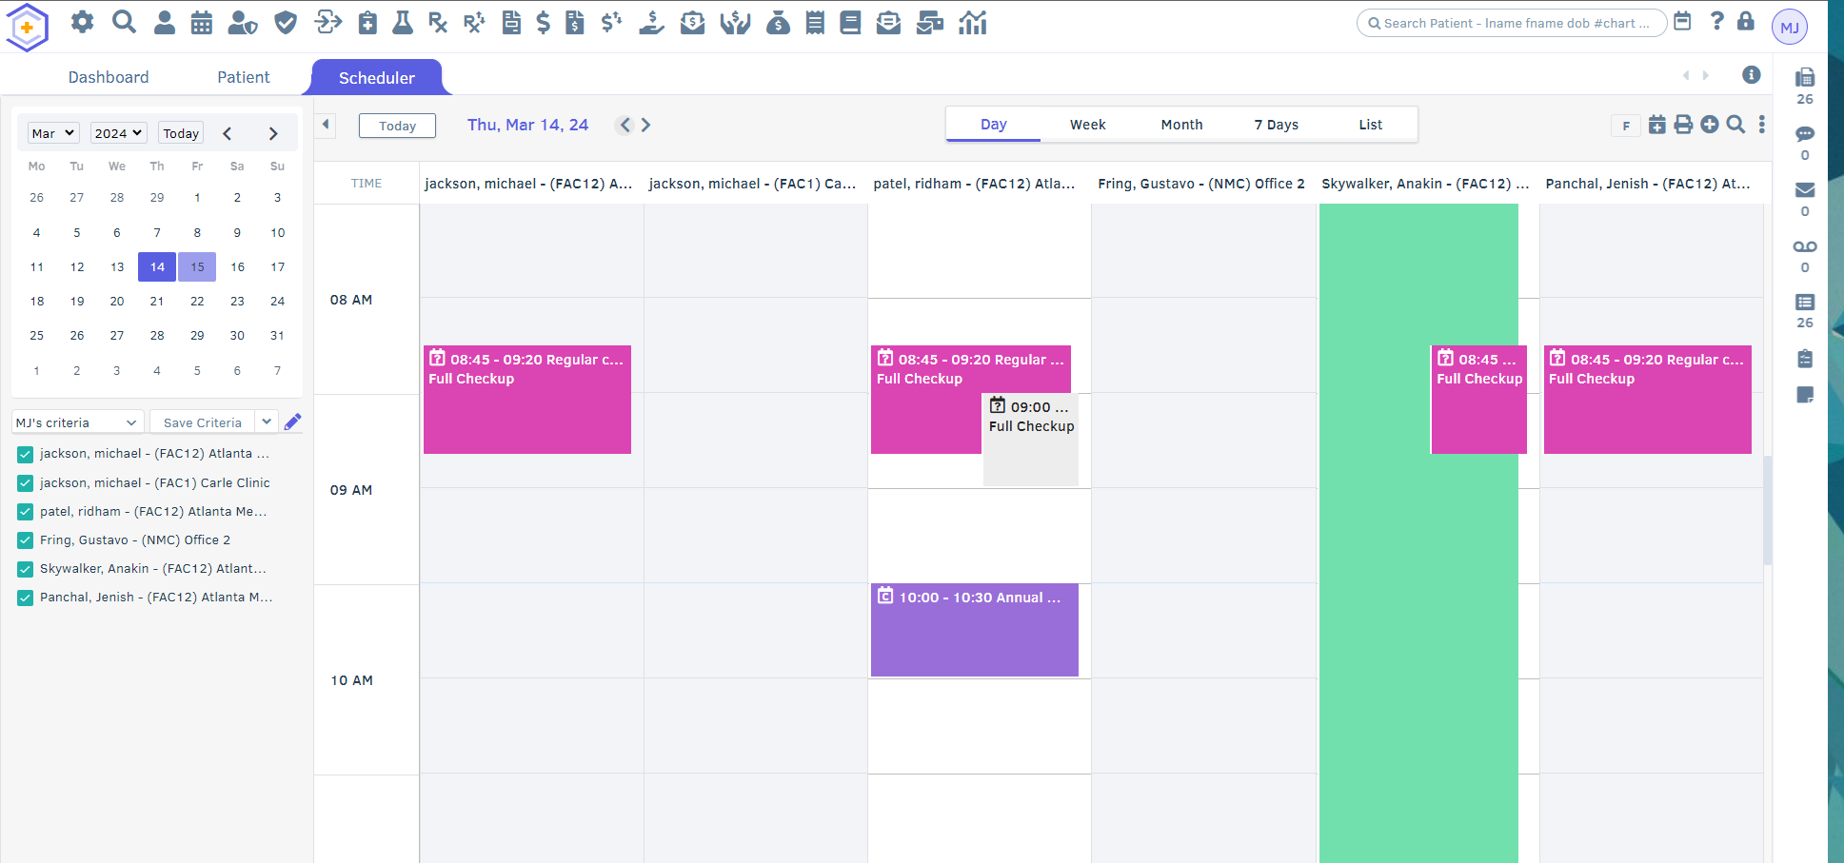

Slide 8
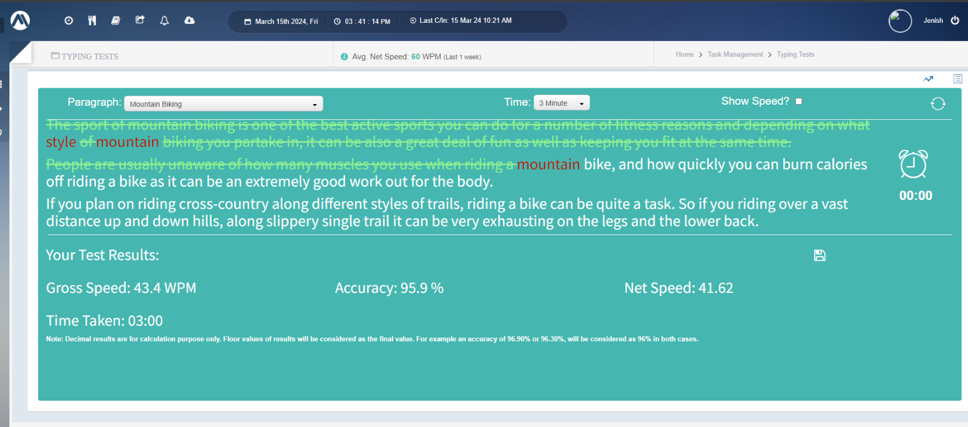
Touch Typing

Slide 9
Week 4: Writing Test Cases of Scheduler Module
Testing different ‘Setups’ of Scheduler Module and wrote test cases for them. Here’s the list of sub-modules of Scheduler.
1). Employee Availability
2). Schedule Template
3). Facility Holiday
4). Visit Type
5). Appointment Reminder Preference

Slide 10
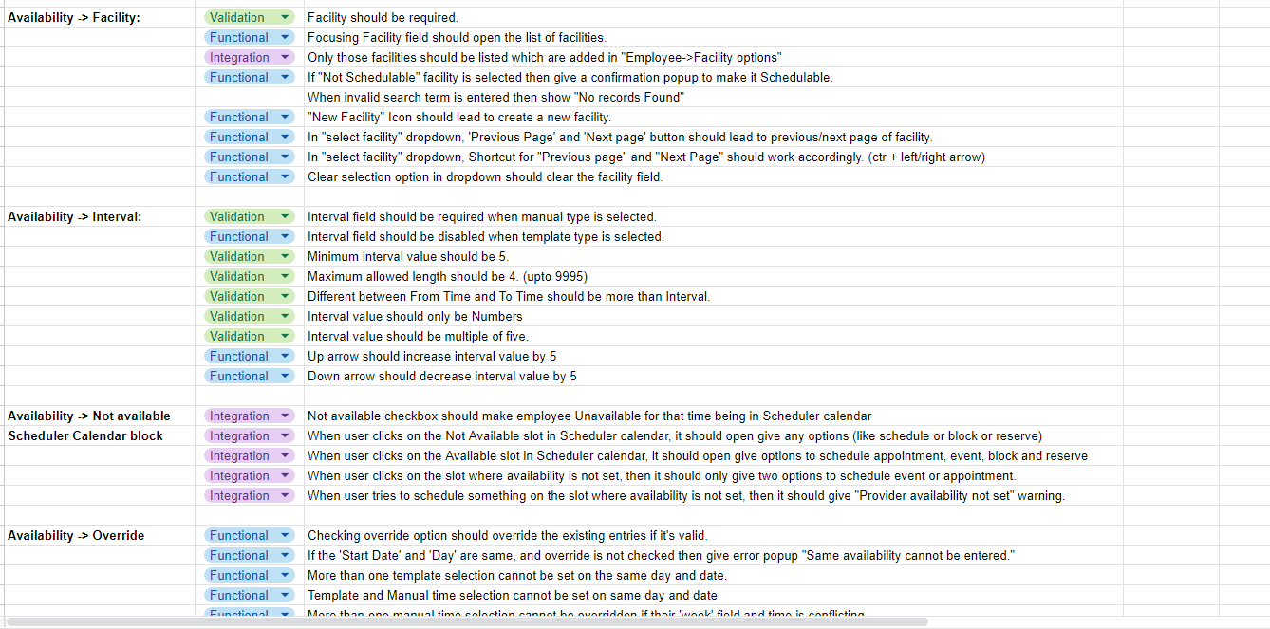

Slide 11
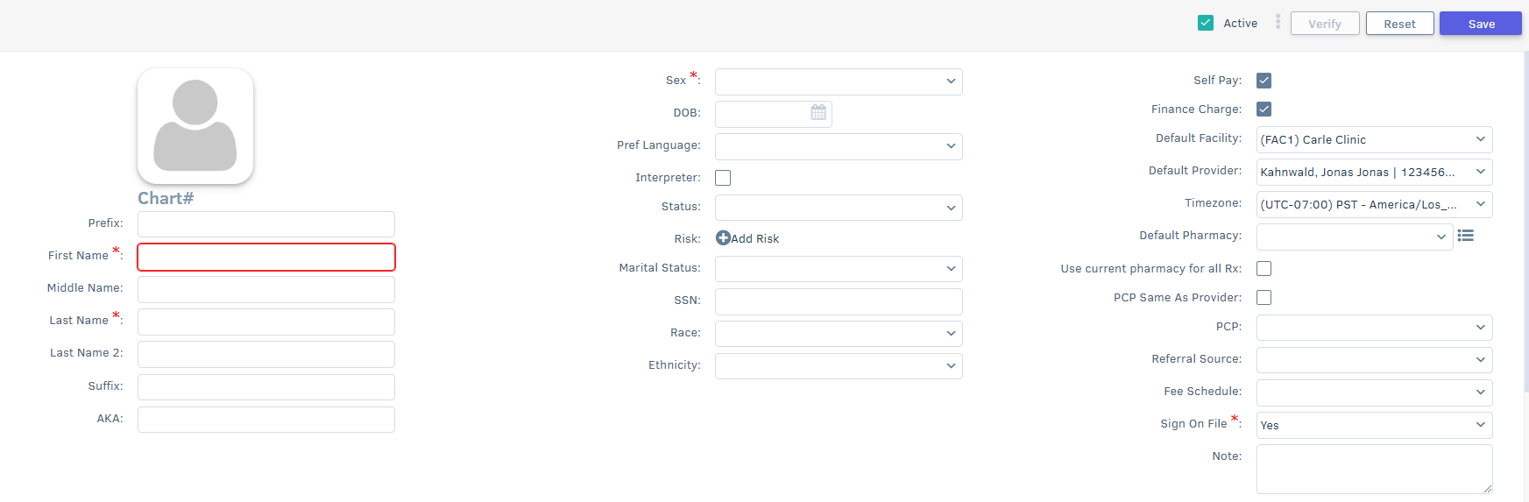
Week 5: HTML, CSS and Touch Typing

Slide 12
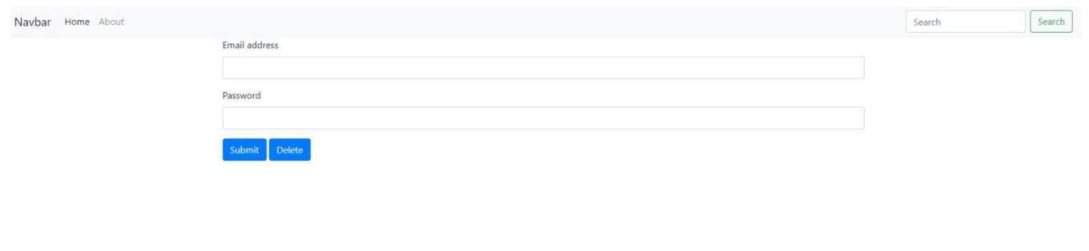
Week 6: Javascript and DOM Manipulation
Attended session on JavaScript and learned DOM manipulation.
Wrote test cases for setups.
Practice of touch typing.

Slide 13
Week 7: Revision of HTML, CSS and JS
1). Revised all concepts of HTML, CSS and JavaScript.
2). Integrating HTML, CSS and JavaScript to make basic web pages.
3). Practiced Touch Typing everyday on MEM portal.
4). Explored Dr. Catalyst product, it’s different modules and wrote test cases of it.

Slide 14
Week 8: OOPs, SQL and Git/Github.
1). Learned Object Oriented Programming concepts.
2). Learned Git and Github and practiced it.
3). Learned Basics of SQL.
4). Achieved minimum required touch typing speed.

Slide 15
Week 9: Various types of testing.
1). Understanding and performing Functional Testing.
2). Performing Non-Functional Testing for software.
3). Validation and UI testing.
4). Implementing various Security and Performance tests.

Slide 16
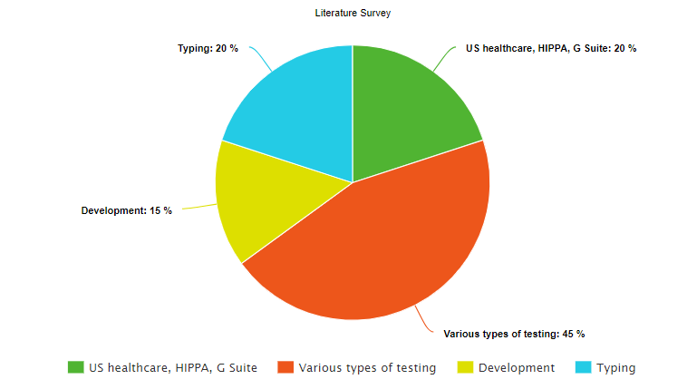
Total Learning:

Slide 17
THANK YOU!

